Slide 1

PATHRISE PROJECT GROUP 12 (CODE SEEKERS)
SPECIAL THANKS TO: MONA HATAMI & DATA ROAD MAP TEAM

Slide 2



WWW.PATHRISE.COM
PATHRISE: Is an online program for tech professionals that provides 1-on-1 mentorship, training and advice to help you land your next job.
PATHRISE LOCATION: San Francisco, CA, US
PATHRISE DATA FROM ebay, Facebook, Visa, Apple, Google, Linkdin,…
PAST DATA FELLOWS PLACED AT: Fedex, Amazon, Vmware,…
PATHRISE FOUNDERS: Kevin Wu & Derrik Mar. in 2017.

Slide 3
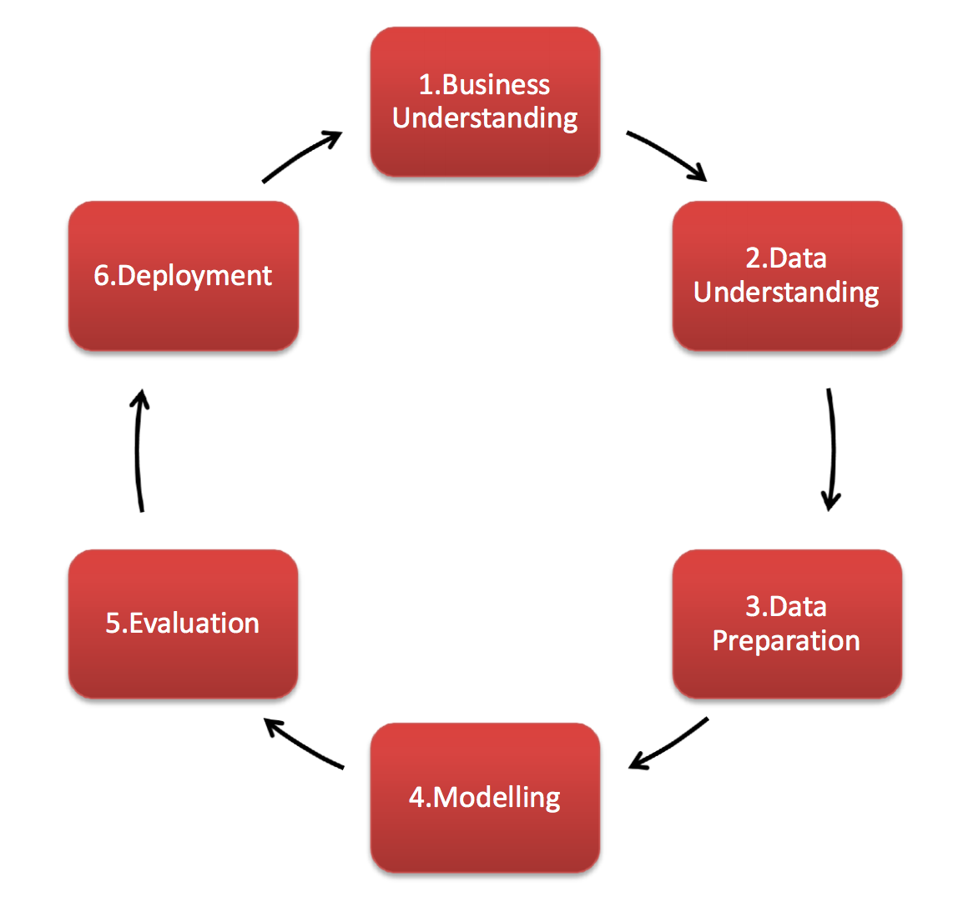

Slide 4

FIRST STEP: BUSINESS UNDERSTANDING
MAIN GOALS:
1. WILL A FELLOW GET PLACED OR NOT?
2. HOW LONG DOES IT TAKE FOR A FELLOW TO GET PLACED?

Slide 5
SECOND STEP: DATA UNDERSTANDING
OUR DATASET INCLUDES BELOW INFORMATION:
2544 ROWS & 16 COLUMNS
TYPES OF DATA: INT/ FLOAT/ OBJECT
INT ( 3 COLUMNS)
FLOAT (2 COLUMNS)
OBJECT (11 COLUMNS)
4

Slide 6
 | Data Type | Target | Remove
ID | int |  | Yes
Pathrise_status | object
Primary_track | object
Cohor_tag | object |  | Yes
Program _duration days | float | Yes
placed | int | Yes
Employment _status | object
Highest_ level _of _education | object
Length_of_job_search | object |  | Yes
Biggest _challenge _in _search | object
professional _experience | object
work _authorization _status | object
Number_of_interviews | float |  | Yes
Number_of_applications | int |  | Yes
Gender | object
Race | object
based on Dataset BELOW columns (INDEPENDENT VARIABLES)WERE CONSIDERED EFFECTIVE ON OUR TARGET (DEPENDANT VARIABLE):

Slide 7
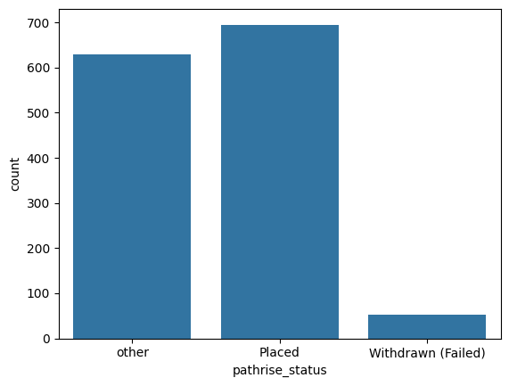
PATHRISE STATUS COLUMN: WE KEPT PLACED-ACTIVE-WITHDRAWN(FAILED) AND REST OF THEM IN ‘OTHER’ GROUP
sns.countplot(x='pathrise_status',data=df)

Slide 8
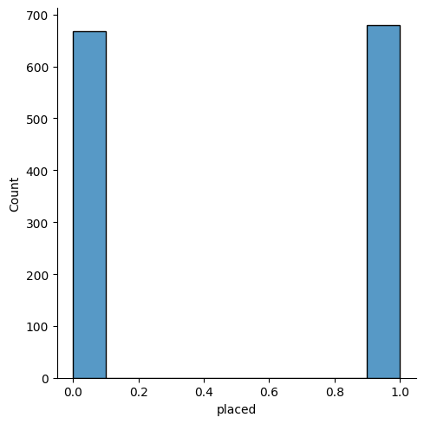
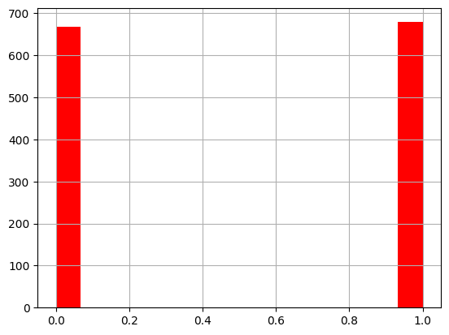
THE COLUMN ‘PLACED’ WAS CHOSEN AS TARGET
HISTOGRAM AND DISPLOT SHOWED SAME RESULTS
sns.displot(x='placed',data=df,bins=10)
df['placed'].hist(bins=15,color='red')

Slide 9
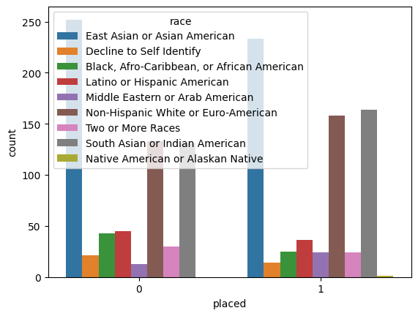
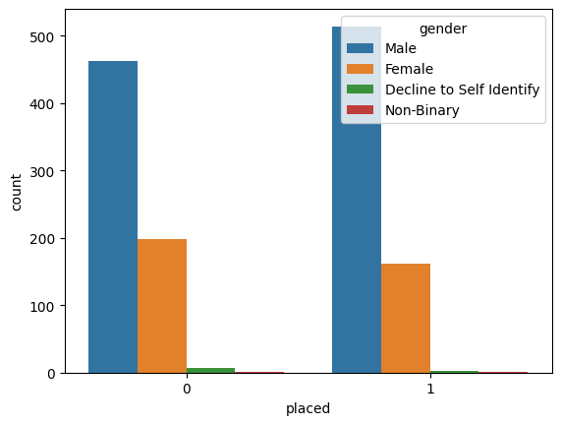
GENDER RACE
Men participated more than women and therefore placed more
East Asian or Asian American were placed more than other races

Slide 10
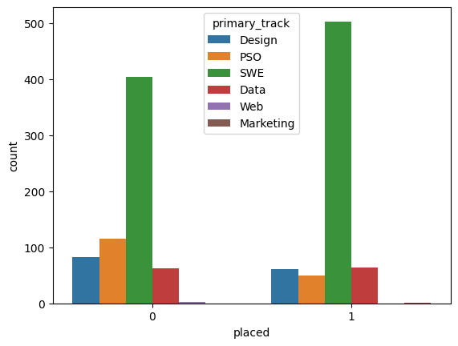
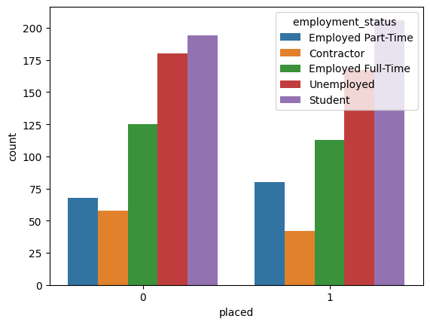
PRIMARY TRACK EMPLOYMENT STATUS
Higher Placement for Software Engineers
Higher Placement for Students and Unemployed

Slide 11
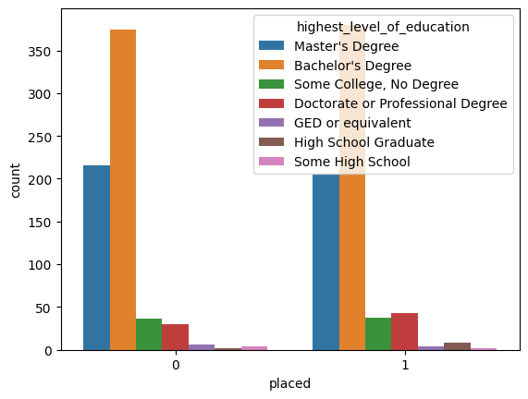
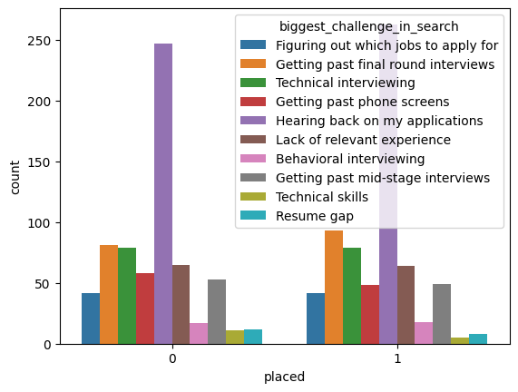
HIGHEST LEVEL OF EDUCATION BIGGEST CHALLENGE BACHELOR’S AND MASTER’S GOT MORE JOBS. HEARING BACK ON THEIR OWN APPLICATIONS

Slide 12
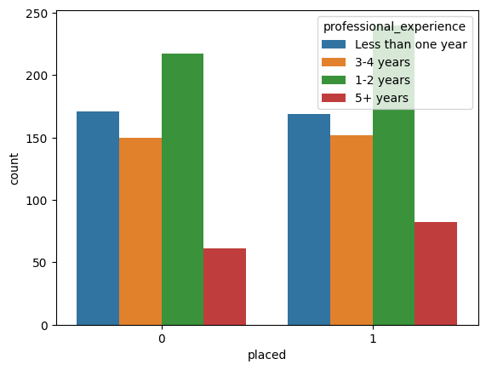
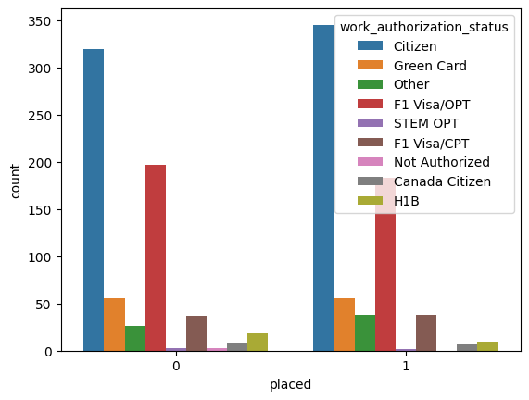
EXPERIENCE WORK-AUTHORIZATION 1-2 YEARS EXPERIENCE PLACED MORE CITIZENS AND GREEN CARD HOLDERS PLACED MORE

Slide 13

Before modeling null values in some columns we removed
df=df[~df[‘column’s name’,’column’s name’,…].isnull()]
 | COLUMNS
1 | Program_duration_days
2 | Employment_status
3 | Highest_level_of_education
4 | Professional_experience
5 | Work_authorization_status
6 | Gender

Slide 14

Before modeling all Objects were converted to Integers
df=pd.get_dummies(df,columns=[‘column’s name’, ‘ ‘],dtype=int)
 | OBJECT COLUMNS
1 | Biggest_challenge_in_search
2 | Employment_status
3 | Highest_level_of_education
4 | Professional_experience
5 | Work_authorization_status
6 | Gender
7 | Race
8 | Pathrise_status
9 | Primary_track

Slide 15
4TH STEP: MODELING
Target
Placed | Program Duration Days
Logistic Regression Linear Regression Random Forest | Linear Regression Decision Tree Random Forest

Slide 16
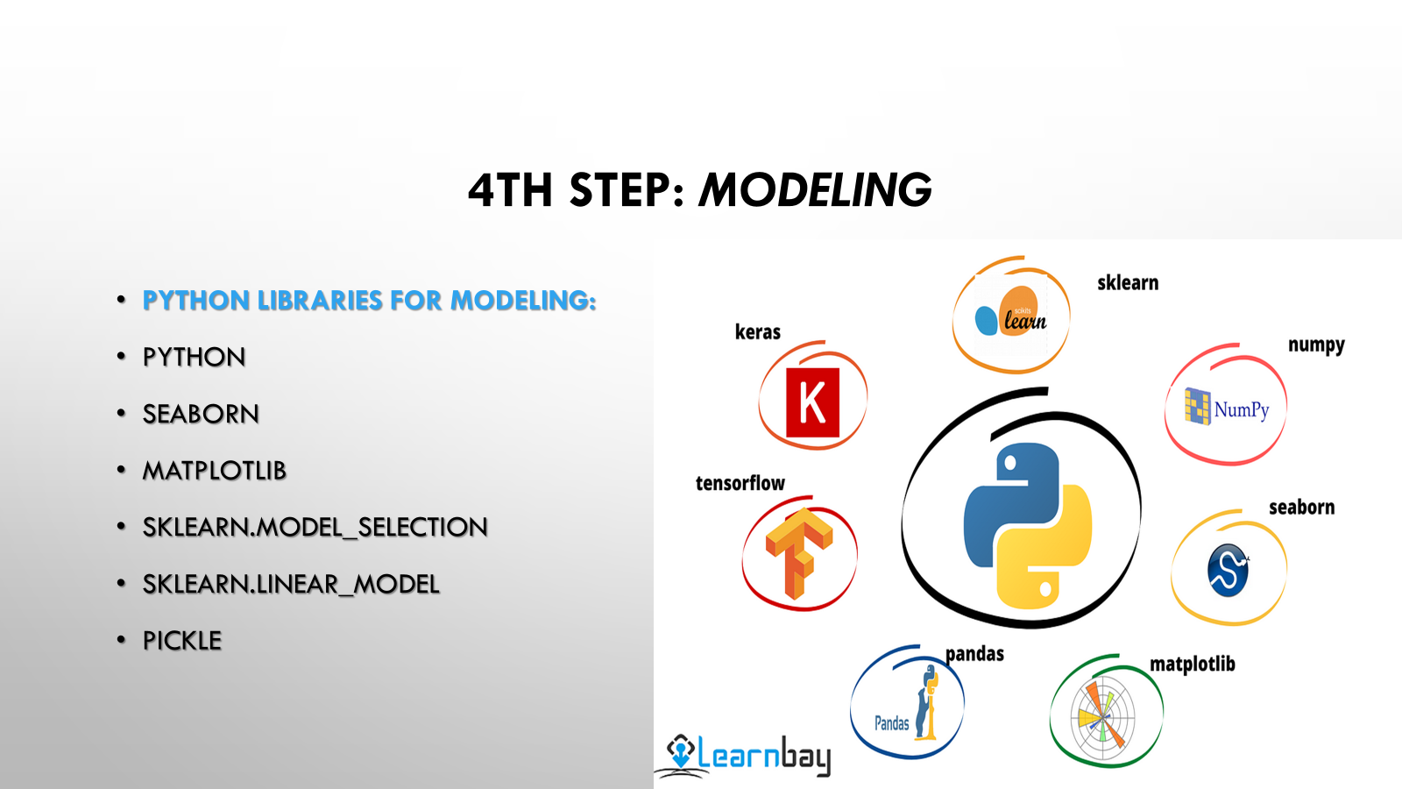

Slide 17
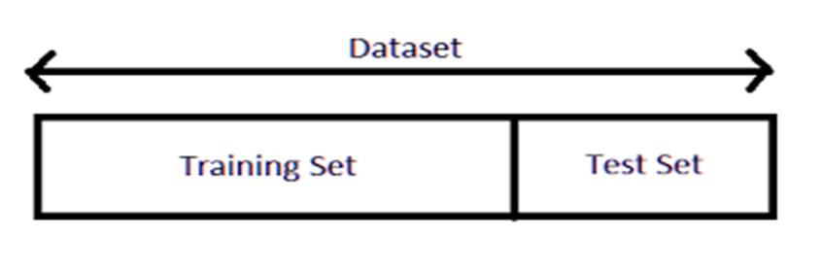
•X=df.drop(columns=‘placed’) #all columns except placed
•Y=df[‘placed’] #Target
Dataset was divided into 2 parts : Test Data (20%) & Train Data (80%) to make sure that our model works and can predict correctly.
•X_test,x_train,y_test,y_train=train_test_split(x,y,test_size=0.2 random_state=101)

Slide 18
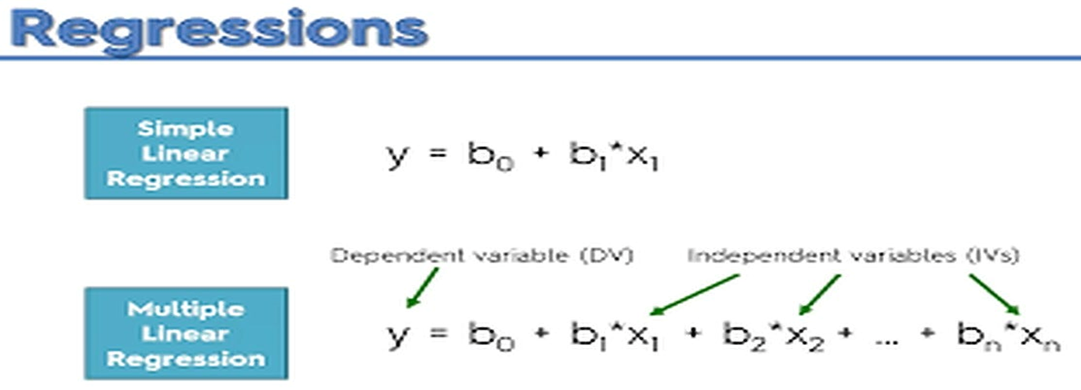
Then Regression Equation and Fit Method were used to train the model and check to see if we can predict the model or not?
Lr=linearregression()
Lr=lr.Fit(x_train,y_train)

Slide 19

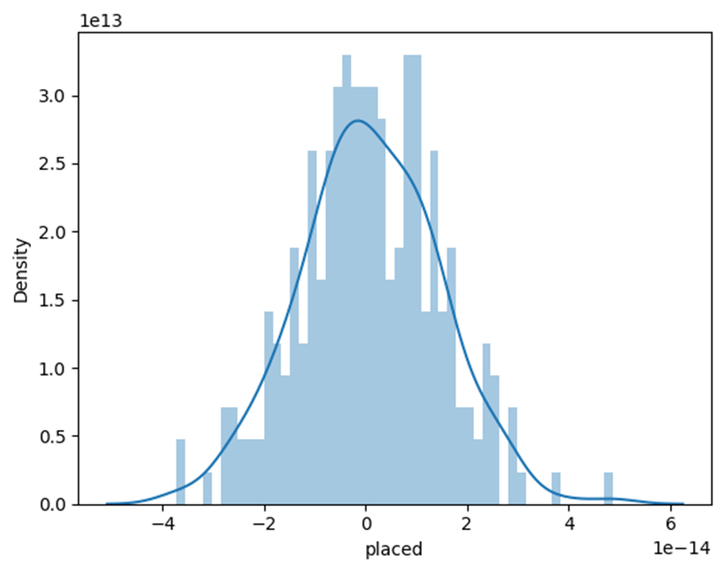
The model shows normal distribution.
If the distribution is around 0,it shows that the prediction is correct.

Slide 20
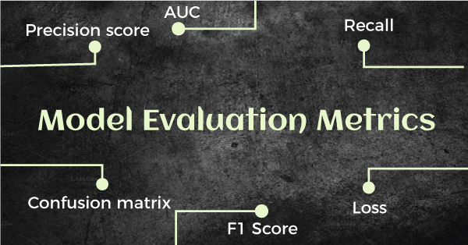
Evaluating Model with Metrics
print(‘MSE:',metrics.mean_absolute_error(y_test,prediction))
MSE: 1.088220831

Slide 21
Logistic Regression
Will a fellow placed or not?
LogisticRegression:(highest Accuracy) KNN: (Lowest Accuracy)
Recall: 98% Accuracy: 76%
F1-Score: 95%
Precision= 89%
Accuracy: 94%

Slide 22
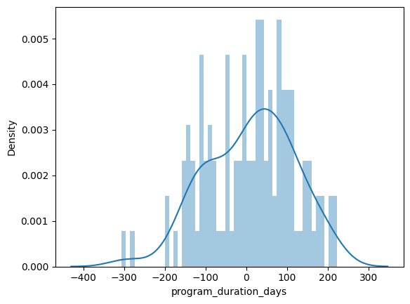
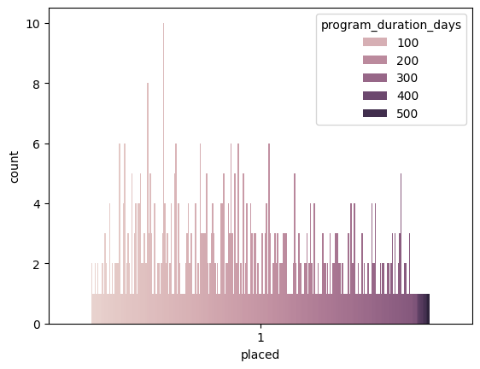
How long does it take to get a job? Supervised learning Regression problem
MSE:88

Slide 23
Recommendations for Pathrise
Encourage female participants to join Pathrise online program
Attract already employed people to get better jobs and promotions
Cooperate with a vast variety of companies could lead to expand the business for Pathrise
Hiring more recruiters to help applicants to get careers more quickly
Reducing monthly fee can help Pathrise to get more applications and better reviews

Slide 24


